Slide 1
Bridge
Lecture 20

Slide 2
Intent
Bridge is a structural design pattern that lets you split a large class or a set of closely related classes into two separate hierarchies—abstraction and implementation—which can be developed independently of each other.

Slide 3
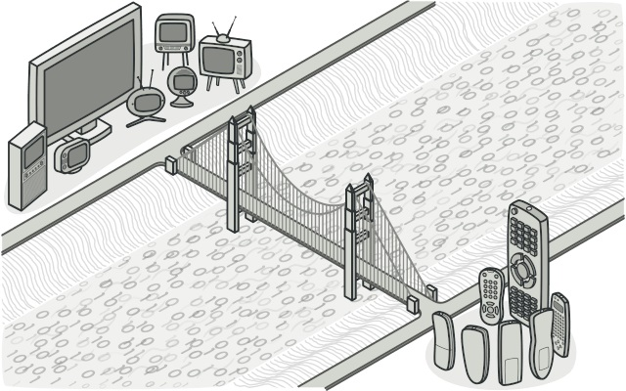

Slide 4
Problem
Say you have a geometric Shape class with a pair of subclasses: Circle and Square.
You want to extend this class hierarchy to incorporate colors, so you plan to create Red and Blue shape subclasses.
However, since you already have two subclasses, you’ll need to create four class combinations
Adding new shape types and colors to the hierarchy will grow it exponentially.

Slide 5
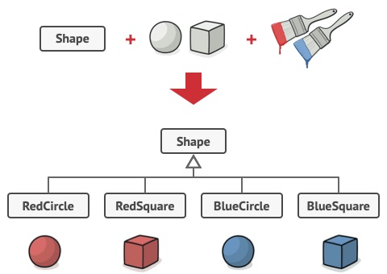

Slide 6
Solution
This problem occurs because we’re trying to extend the shape classes in two independent dimensions: by form and by color. That’s a very common issue with class inheritance.
The Bridge pattern attempts to solve this problem by switching from inheritance to the object composition.
What this means is that you extract one of the dimensions into a separate class hierarchy, so that the original classes will reference an object of the new hierarchy, instead of having all of its state and behaviors within one class.

Slide 7
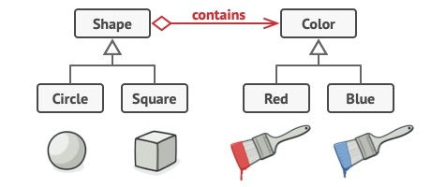

Slide 8
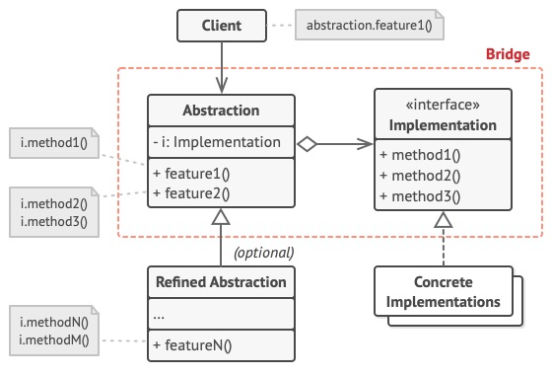

Slide 9
Example
This example illustrates how the Bridge pattern can help divide the monolithic code of an app that manages devices and their remote controls. The Device classes act as the implementation, whereas the Remotes act as the abstraction.

Slide 10
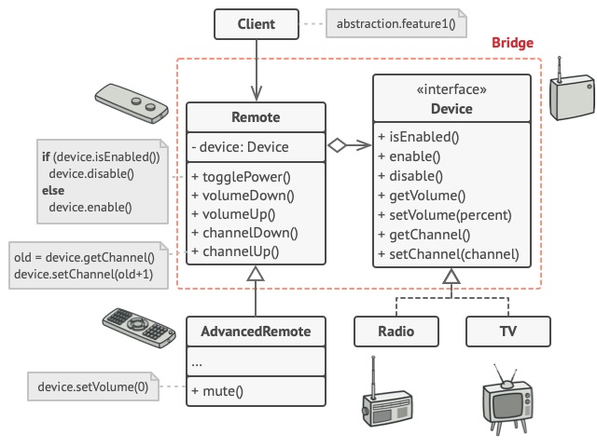

Slide 11
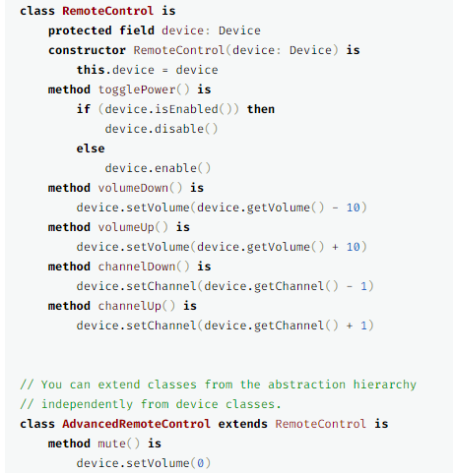

Slide 12
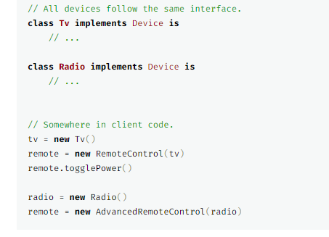

Slide 13
Advantages
You can create platform-independent classes and apps.
The client code works with high-level abstractions. It isn’t exposed to the platform details.
Open/Closed Principle. You can introduce new abstractions and implementations independently from each other.
Single Responsibility Principle. You can focus on high-level logic in the abstraction and on platform details in the implementation.

Slide 14
Disadvantage
You might make the code more complicated by applying the pattern to a highly cohesive class.

Slide 15
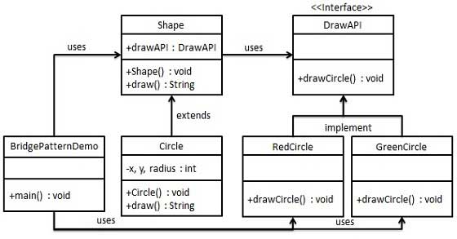
Example

Slide 16
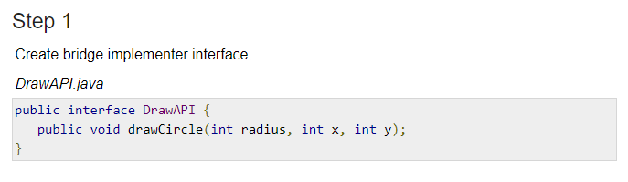

Slide 17
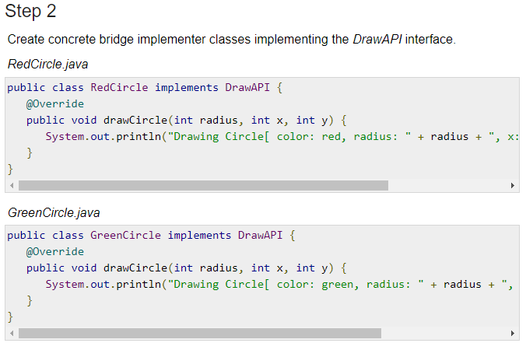

Slide 18
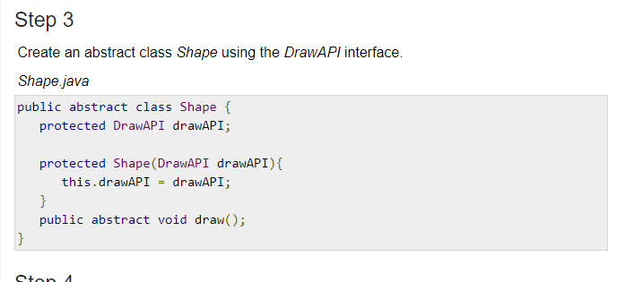

Slide 19
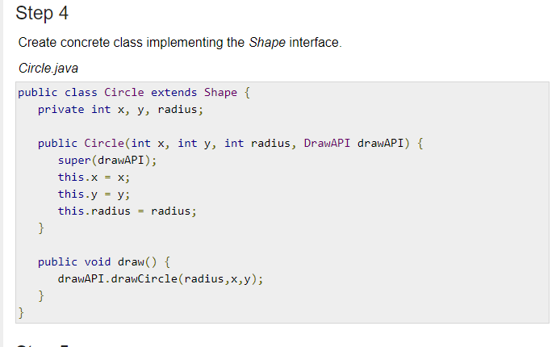

Slide 20
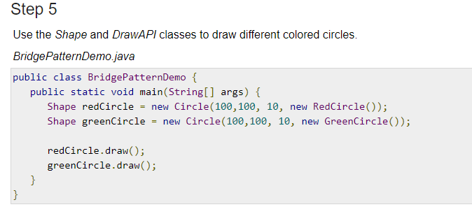

Slide 21
Reference
https://www.tutorialspoint.com/design_pattern/bridge_pattern.htm
https://refactoring.guru/design-patterns/bridge

